Slide 1
Performance Forecasting
D. Djurdjanovic, J. Lee and J. Ni, “Watchdog Agent – An Infotronics Based Prognostics Approach for Product Performance Degradation Assessment and Prediction”, International Journal of Advanced Engineering Informatics, Vol. 17, No. 3 -4, pp. 109-125, 2003.

Slide 2
Industry Needs
WHEN ?
For how long can we still run the machine ?
Is the machine going to break down if it works 12 more hours?
WHY ?
What type of degradation process is it ?
dust accumulation ? tool wearing out ?
or a process that never occured before?
WHAT to do ?
If the degradation process is known, do we have the required equipment to fix the machine ? Do we need to order a new piece?

Slide 3
Autoregressive Moving Average (ARMA) Model Based Prediction
F(0)
F(1)
F(2)
F(N)
F_{N}(1)
F_{N}(2)
F_{N}(3)
time
t = 0
t =1
t =2
…
t =N
t=N+1
t=N+2
t=N+3
Past
Present
Future
Normal Behavior
Model of Failure
F(t)=[f₁(t) f₂(t)], t=1,2,3,…,N
Feature f₂
Legend
Predicted Probability of Failure
Past Performance Signatures
0
Predicted Confidence Value
ARMA Prediction
Prediction Uncertainty
Feature f₁

Slide 4
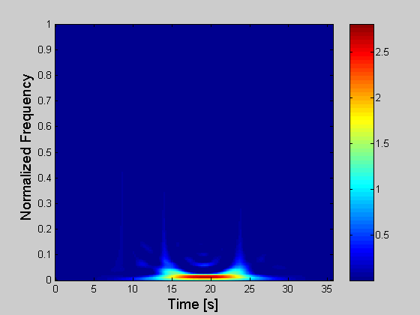
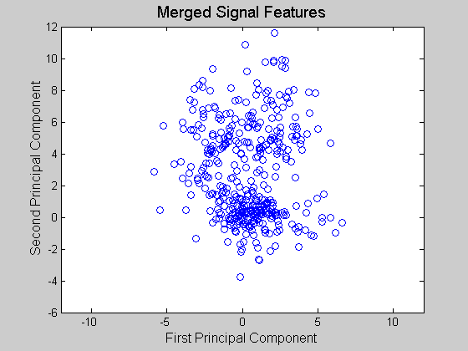
Data Collection and Processing
Automotive E-Manufacturing testbed
Spindle Load of a Boring Machine
Joint Time-Frequency Distribution
Sampling rate = 200Hz
Principal Components from TF Moments
ARMA Prediction of Process Features

Slide 5
Prediction of Boring Process Signatures
Systematic data collection
Performance Evaluation
E-Manufacturing testbed
Multi-sensor fusion
CV calculation
Flexibility
Data search by: Plant, Machine, Sensor, Date, Time
First 265 samples for modeling
Principal Component
Cycle Number

Slide 6
Prediction of Boring Process Signatures
Systematic data collection
Performance Evaluation
E-Manufacturing testbed
Multi-sensor fusion
CV calculation
Flexibility
Data search by: Plant, Machine, Sensor, Date, Time
First 265 samples for modeling
Predict Next 15 samples
Principal Component
Cycle Number

Slide 7
Prediction of Boring Process Signatures
Systematic data collection
Performance Evaluation
E-Manufacturing testbed
Multi-sensor fusion
CV calculation
Flexibility
Data search by: Plant, Machine, Sensor, Date, Time
First 265 samples for modeling
Predict Next 15 samples
Principal Component
Obtain Prediction Uncertainty
Cycle Number

Slide 8
Prediction of Boring Process Signatures
Systematic data collection
Performance Evaluation
E-Manufacturing testbed
Multi-sensor fusion
CV calculation
Flexibility
Data search by: Plant, Machine, Sensor, Date, Time
First 265 samples for modeling
Predict Next 15 samples
Principal Component
Obtain Prediction Uncertainty
Compare with actual data
Cycle Number

Slide 9
Prediction of Boring Process Signatures
Systematic data collection
Performance Evaluation
E-Manufacturing testbed
Multi-sensor fusion
CV calculation
Flexibility
Data search by: Plant, Machine, Sensor, Date, Time
Principal Component
Cycle Number

Slide 10
Evaluation of Prediction Result
Starting point for prediction | Lower predicted cross-over cycle number | Upper predicted cross-over cycle number | Prediction Interval
255 | 257 | 323 | 66
265 | 268 | 312 | 44
275 | 277 | 316 | 39
283 | 284 | 310 | 26
284 | 287 | 310 | 23
285 | 286 | 310 | 24
286 | 287 | 288 | 1
287 | 288 | 288 | 0
Actual unacceptable behavior occurred at cycle number 288
Notes:
Ladies and Gentleman ; Good (Morning Afternoon)!
I am Xue Wang from Tsinghua University , China . Now, I am a visitor scholar in IMS Center UWM.
Today, My presentation topic is Prognostic and Diagnostic

Slide 11
Evaluation of Prediction Result
Actual unacceptable behavior occurred at cycle number 288
Notes:
Ladies and Gentleman ; Good (Morning Afternoon)!
I am Xue Wang from Tsinghua University , China . Now, I am a visitor scholar in IMS Center UWM.
Today, My presentation topic is Prognostic and Diagnostic

